Slide 1
Doing Classical Item Analyses Prior to Specification of and IRT Model
Derek Briggs
EDUC 8720

Slide 2
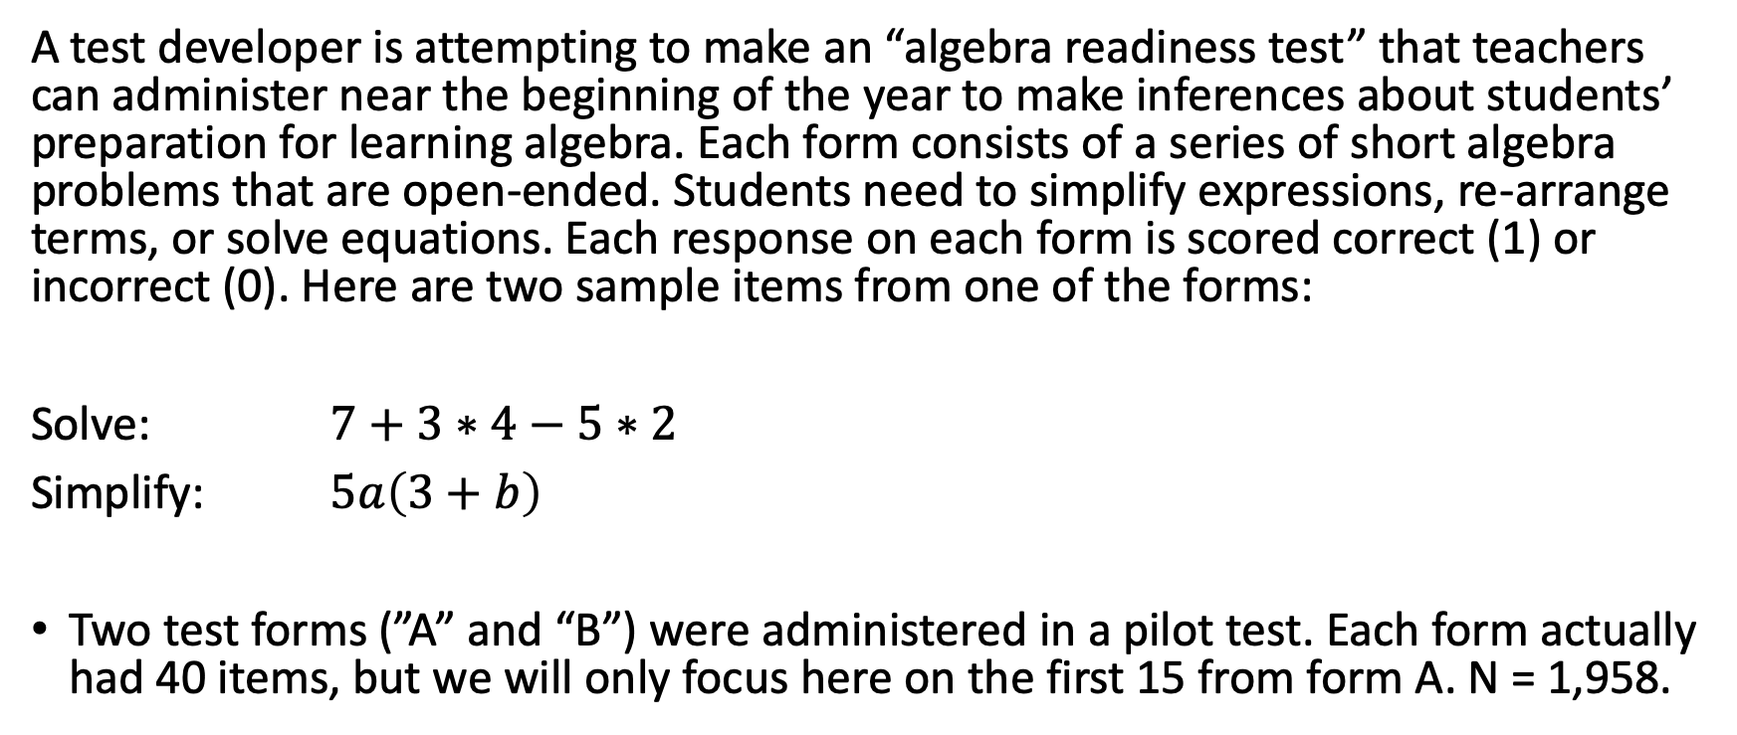
Some Motivating Data
A test developer is attempting to make an “algebra readiness test” that teachers can administer near the beginning of the year to make inferences about students’ preparation for learning algebra. Each form consists of a series of short algebra problems that are open-ended. Students need to simplify expressions, re-arrange terms, or solve equations. Each response on each form is scored correct (1) or incorrect (0). Here are two sample items from one of the forms:
Solve: $7+3∗4−5∗2$
Simplify: $5a\left(3+b\right)$
Two test forms (”A” and “B”) were administered in a pilot test. Each form actually had 40 items, but we will only focus here on the first 15 from form A. N = 1,958.

Slide 3
Warm-Up Activity
Download the file “pset1_formA.csv”
Open the R script file “lb_irt_012626.r”
Follow along by running the commands in “PART 1”
Use the function alpha from the package psych to examine the classical item statistics.
Next, create item characteristic curve plots for the Form A data.
Use the total score as the x-axis variable.
Do you think an IRT model will fit these data? If so, which one and why? If not, why not?

